Slide 1
Nano Conference #8
Beyond the Classroom.
Online. Bite-sized. Convenient.
Coventry University Group | Academic Enhancement & Professional Development
February 2024
Notes:
Overall welcome to CU Nano Conference
Before cover some important housekeeping items.
Image: Marvin Meyer, unsplash.com

Slide 2
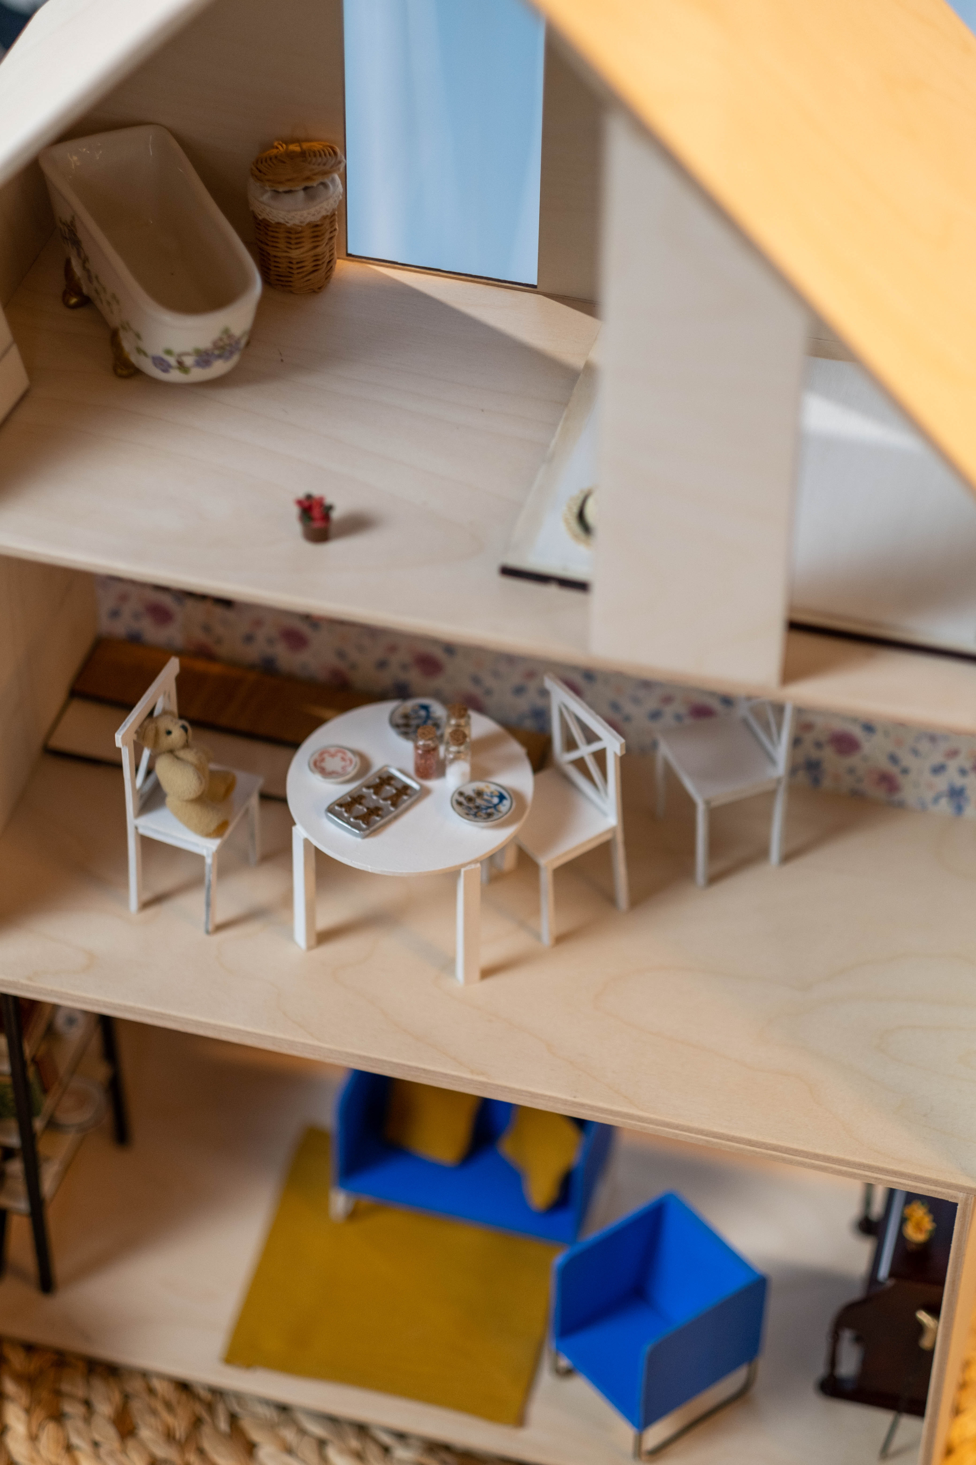
Housekeeping
Presentations are recorded
Use Zoom chat
Closed captions available
Presenter resources/slides via Nano site
Ed Tech Support: Jonathan Mason in Zoom
Nano feedback form
Break at 11:20am (10 mins)
Save the date: Nano #9 26th June
Become a future Nano presenter
Image: Foto Phanatic, Unsplash
Notes:
Feedback FORM: https://forms.office.com/pages/responsepage.aspx?id=mqsYS2U3vkqsfA4NOYr9T23EWtSSDiVEi47TJDccIG9UMFdVRzZVQkxUWlZaSENNVkwxMUZPSzcwRy4u
Register to present: https://forms.office.com/pages/responsepage.aspx?id=mqsYS2U3vkqsfA4NOYr9T23EWtSSDiVEi47TJDccIG9UNFdBQlI0U01TWFRUVTIwNFFRNlhFNldaWi4u
Presenter Slides & Resources:

Slide 3
10 min. break
Back at 11:30am
Image: Joanna Kosinska, Unsplash
Notes:
Tell attendees WHAT TIME we resume (10 mins. Break).
Display CLOCK on laptop.

Slide 4
Close
Thank you!
Reminders:
Feedback form
Queries: nanocon@coventry.ac.uk
Today's Recordings
Nano team follow-up email
Save the date
26th June 2024
Present at Nano!
Image: Jess Bailey, Unsplash
Notes:
Re-share links
A big thank you to all our presenters AND to you! Your chat is fast becoming a vast learning resource for everyone in this community.
Resources: will be circulated via Nano email with links to previous recordings, too.
Register interest to present with us, perhaps team up with your students to share insights.
Image: Jess Bailey_unsplash.com

